Slide 1

FITNESS FREAKZZ
Crafting a Dynamic Gym Website - Unveiling a Fusion of Innovation and Fitness
Prepared By
Mohammed Amir Ur Rahman,
Mohammed Hamed Hussain Awad ,
Mohammed Mohsin Uddin

Slide 2
Context
Abstract
Key Features
Literature Survey
System Architecture Diagrams
System Architecture
Implementation
Project Description
Project Scope
Features
Programming Languages
System Requirements
Conclusion
Future Enhancement

Slide 3
Abstract
This HTML document represents a webpage designed for Fitness Freakzz, a website focused on promoting fitness and providing resources for various workout routines. The webpage features a structured layout comprising a header, video background, main content section, and footer.
Header Section:
  The header contains a navigation bar with links to different sections of the website, including workouts, sports, care, yoga, and a store. Additionally, there's a login button for user authentication.
Video Background:
  A video background is incorporated into the webpage, set to auto play and loop with muted audio. This feature enhances the visual appeal and engagement of the site.
Main Content Section:
  The main content section showcases a centered heading emphasizing the brand "FITNESS FREAKZZ" and a subheading that conveys the website's dedication to promoting fitness as a worthwhile pursuit.
Workout Categories:
  The webpage offers various workout categories, presented as clickable boxes within a container. Each category box includes an image representing the workout type and descriptive text, providing users with quick access to different exercise routines.
Footer Section:
  The footer section completes the webpage, featuring horizontal rules for visual separation, a list containing website information such as FFTZZ and copyright details, and another horizontal rule for additional delineation.

Slide 4
Key Features
Key features include user authentication, personalized member profiles, class schedules, trainer details, and online booking. The website will prioritize responsive design for accessibility across devices. System requirements encompass a Core i5 processor, Windows 10 OS, modern web browsers, and a stable internet connection. This integration of technology and programming languages will deliver an intuitive, feature-rich gym platform meeting diverse user needs.

Slide 5
Literature Survey
A literature survey of the provided HTML code, which represents a webpage for Fitness Freakzz, a fitness-oriented platform, can explore various aspects of web development, design principles, and user experience considerations. Here's a breakdown of the literature survey based on different areas:
1. **HTML and CSS Development**:
- **HTML5 and CSS3**: The code utilizes modern HTML5 markup and CSS3 styling techniques to structure and design the webpage, showcasing familiarity with contemporary web development standards.
2. **Web Design Principles**:
- **Visual Hierarchy**: The webpage employs a clear visual hierarchy with prominent headings, descriptive text, and visually appealing images to guide users' attention and engagement.
- **Color and Typography**: The choice of colors and typography enhances the overall aesthetic appeal and readability of the webpage, contributing to a cohesive and engaging user experience.
3. **Branding and Messaging**
- **Brand Identity**: The consistent use of branding elements, such as the Fitness Freakzz logo and brand colors, reinforces the website's identity and fosters brand recognition among users.

Slide 6
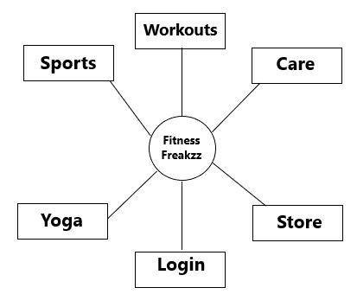
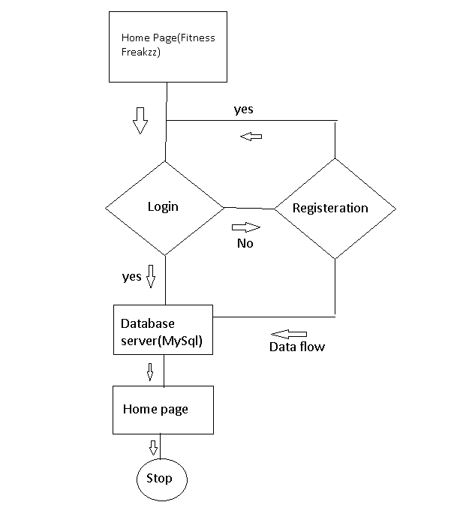
System Architecture Diagram
Main Page
Login Page

Slide 7
System Architecture
Classification | Existing System | Propose System
Main Page Features | Navigation bar, background color, Main page description | Navigation bar, background Video, Main Page Description, Footer-Copy right
Navigation Bar | Workouts, Sports, Login | Workouts, Sports, Care, Yoga, Stores, Login
Programming Languages | HTML, CSS | HTML, CSS, JAVASCRIPTS AND MY SQL.
Workouts features | Description of different Workouts With Images | Description of different Workouts With Hyperlink connecting to the videos and description of major Workouts in Different Categories
Login Page | Basic Login page consist of only html tags | Login page consist of Html Tags ,CSS and Data base connectivity

Slide 8
Implementation
Implementing the Fitness Freakzz website involves translating the provided HTML code into a functional web application using appropriate technologies and tools. Here's a step-by-step guide for implementing the website:
1. **Setup Development Environment**:
- Install a text editor or integrated development environment (IDE) such as Visual Studio Code, Sublime Text, or Atom for writing code.
- Install Node.js and NPM (Node Package Manager) to manage dependencies and run JavaScript-based server-side code.
2. **Create Project Structure**:
- Set up a project directory for the website and organize files accordingly. Create separate folders for HTML, CSS, JavaScript, and other assets.
- Create subfolders within the project directory for images, videos, and any other static resources used on the website.
3. **HTML Structure**:
- Copy the provided HTML code into an `index.html` file within the HTML folder.
- Update file paths for images, videos, and other static assets to reflect the correct directory structure.
- Ensure that HTML markup is valid and semantic, adhering to best practices for accessibility and SEO.
4. **CSS Styling**:
- Create a `style.css` file within the CSS folder to contain custom styles for the website.
- Copy relevant CSS rules from the provided code or write new styles to achieve the desired layout, typography, colors, and visual effects.
5. **JavaScript Functionality**:
- If needed, create a `script.js` file within the JavaScript folder to include client-side scripting for interactive elements or dynamic behavior.

Slide 9
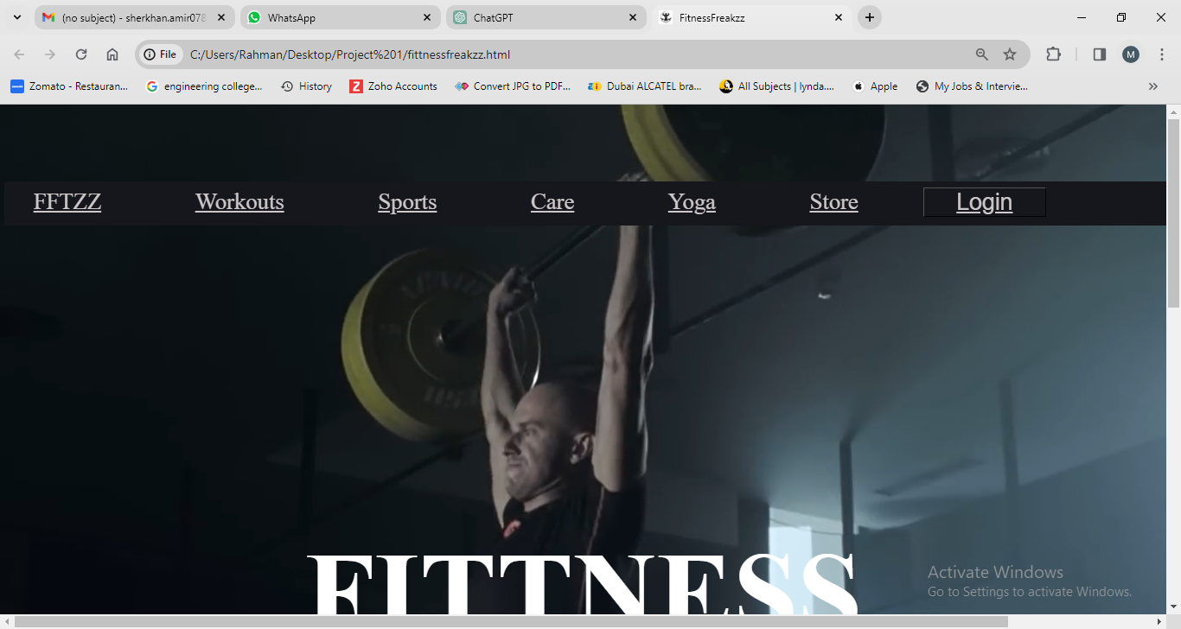
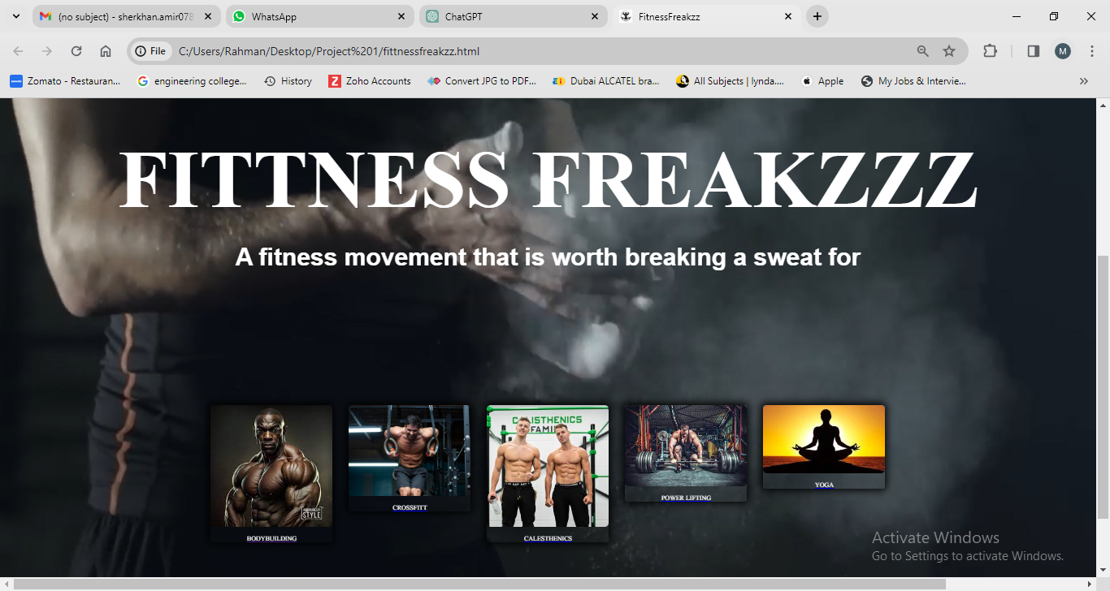
SnapShots

Slide 11
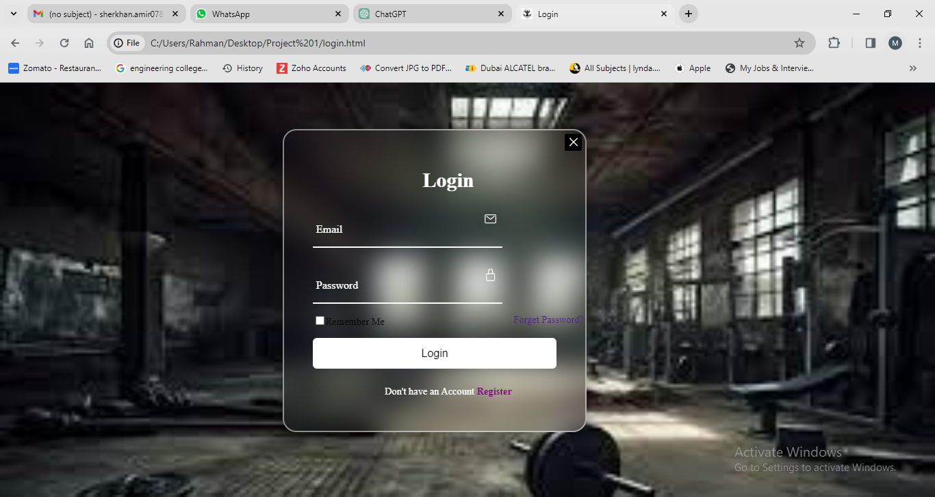
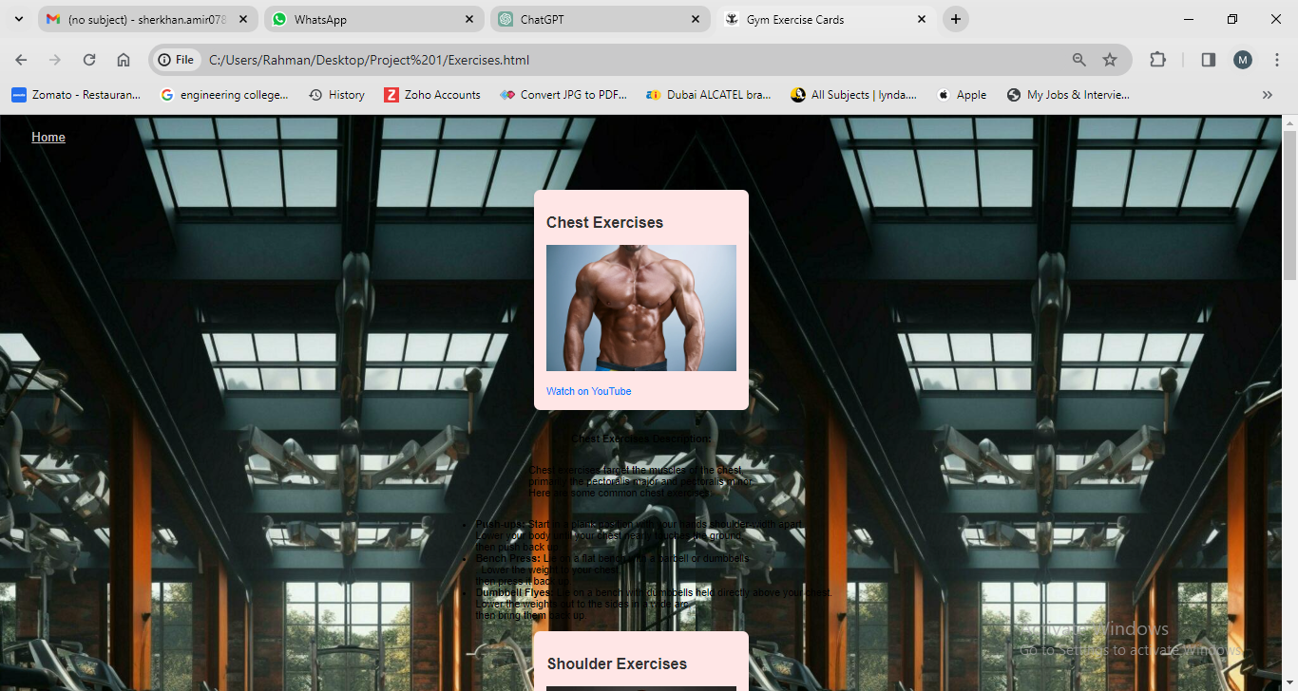

Slide 12
Project Description
**General Description:**
The Fitness Freakzz website is a comprehensive online platform dedicated to promoting fitness, providing workout routines, sports-related content, wellness resources, yoga practices, and a store for fitness essentials. The website aims to inspire and guide users on their fitness journey by offering diverse workout options, valuable information, and a supportive community environment.
**Methodologies:**
1. **Agile Development:** The project follows an Agile development methodology, allowing for iterative development, continuous feedback, and incremental improvements based on user needs and market trends.
2. **User-Centric Design:** The website is designed with a focus on user experience (UX), ensuring intuitive navigation, engaging content presentation, and accessibility features to accommodate users of all abilities.

Slide 13
Modules:
Navigation Module
Workout Categories Module
Video Background Module
User Authentication Module
Content Management Module
Techniques Used
HTML5/CSS3
JavaScript/ES6
MongoDB
Responsive Web Design
Content Delivery Network
(CDN)
User Authentication and
Authorization:

Slide 14
Project Scope
1. Background:
2. **Goals:**
3. **Features:**
- **Navigation Menu:**
- **Homepage:**
- **Fitness Categories:**
- **Store:**
- **Footer:**
4. **Technical Requirements:**
- HTML, CSS, and JavaScript for front-end development.
- Database (e.g., MySQL) for storing product information and user data (if applicable).

Slide 15
5. **Timeline:**
- Phase 1: Planning and Design (2 weeks)
- Phase 2: Front-end Development (4 weeks)
- Phase 3: Back-end Development and Integration (4 weeks)
- Phase 4: Testing and Quality Assurance (2 weeks)
- Phase 5: Deployment and Launch (1 week)
6. **Deliverables:**
- Functional website with all specified features and content.
- Source code and documentation for future maintenance and updates.
- User manual or guide for website administrators (if applicable).
- Training sessions for staff responsible for website management (if applicable).
7. **Budget:**
8. **Stakeholders:**
- Project Manager:.
- Development Team:
- Client Representatives:
- End Users:
9. **Risks and Challenges:**
10. **Success Criteria:**
11. **Future Enhancements:**

Slide 16
Features
Navigation Bar
Video Background
Workout Categories
Responsive Design
User Authentication Button
Footer Section
Interactive Elements
SEO-Friendly Markup
Visual Styling

Slide 17
Programming Languages
HTML
CSS
JAVASCRIPT
VISUAL STUDIO
My SQL

Slide 18
System Requirements
Operating System : windows 10 or latest version
Processor : Core i5,i7 (any)
RAM : 4GB+
Storage : 500GB+

Slide 19
Conclusion
The Fitness Freakzz website presents a dynamic and visually appealing platform for fitness enthusiasts to explore various workout categories, access instructional videos, and engage with fitness-related content. With its intuitive navigation, immersive video background, and responsive design, the website aims to inspire and support users in their fitness journey.
By leveraging modern web development technologies and design principles, Fitness Freakzz provides a seamless and engaging user experience across different devices and screen sizes. The incorporation of interactive elements, user authentication features, and SEO-friendly markup enhances usability, accessibility, and discoverability, further enriching the website's value proposition.

Slide 20
Future Enhancements
While the current version of Fitness Freakzz offers a solid foundation, there are several opportunities for future enhancements and expansions to enrich the user experience and extend the website's functionality:
1. **User Profiles and Social Integration:**
- Implement user profiles with features for tracking progress, setting fitness goals, and connecting with other users.
2. **Personalized Recommendations:**
- Incorporate machine learning algorithms to analyze user preferences and behavior, providing personalized workout recommendations and content suggestions.
3. **Community Forums and Challenges:**
- Introduce community forums or discussion boards where users can share tips, advice, and success stories, fostering a sense of community and support.
4. **E-commerce Expansion:**
- Expand the e-commerce section to offer a wider range of fitness products, nutritional supplements, and merchandise.Implement features for user reviews, product recommendations, and personalized
5. **Mobile App Development:**
- Develop a companion mobile app for FitnessFreakzz to provide on-the-go access to workouts, progress tracking, and community interaction.

Slide 21
THANK YOU

